Slide 1
Chapter 1
Human Development: Approaches and Theories
Notes:
Add slide notes here

Slide 2
Defining Development
Development:
  Systematic changes and continuities in the individual that occur between conception and death
    Biological/Physical development
    Cognitive development
    Psychosocial development
Growth: Physical changes that occur from conception to maturity
Biological aging: Deterioration of organisms that leads to death
Not just physical!
  Cognitive
  Socioemotional
Notes:
Cognitive: maturation of thought processes and tools we use to obtain knowledge, become aware of the world, and solve problems.
Socioemotional: changes in personality, emotions, views of oneself, social skills, and interpersonal relationships.

Slide 3

The Biopsychosocial Approach
Developmental Science is interdisciplinary by nature!
Changes over the lifespan???

Slide 4
Cultural Differences in Adulthood (1 of 2)
Culture impacts the recognized periods of the life span.
  When are you considered an adult?

Slide 5
Cultural Differences in Adulthood (2 of 2)
Rite of passage:
  Ritual that marks a person’s “passage” from one status to another
  Examples:
    Bar or bat mitzvahs
    Quinceañera
Age norms:
  Society’s way of telling people how to act their age
  Influence people’s decisions about how to lead their lives
Social clock:
  Person’s sense of when things should be done and when they are ahead of or behind the schedule dictated by age norms

Slide 6
Socioeconomic Status (SES)
Standing in society based on occupational prestige, education, and income
Individuals from lower-income families tend to reach milestones of adulthood earlier.
Why is this the case?

Slide 7
Basic Issues in Development (1 of 2)
Development is Characterized by Continuity and Discontinuity
  Continuous: slow and gradual change (Slow and steady)
    Example: Language development (growing vocabulary, learning grammar rules, etc.)
  Discontinuous: abrupt change (Sudden Change!) (distinct stages)
    Example: Walking milestones (Sitting up → Crawling → Walking)

Slide 8
Basic Issues in Development (2 of 2)
Nature and Nurture Influence Development
Nature-nurture debate: the struggle over whether development is caused by nature (genetics) or nurture (environment)
  Nature: genetic endowments or heredity, maturational processes, and evolution
  Nurture: physical and social environment
Is one more important?

Slide 9

History of Development: Early Beginnings
Baby biographies:
  Scholars observe the growth and development of their own children.
  Problem with studying your own kids?
    A bit biased?
    Not generalizable to other children!
    Difficult to compare

Slide 10
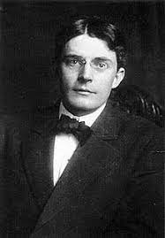
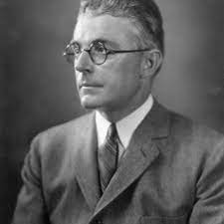
Early Theories: Behavioris
John Watson (1878–1958) - infants’ minds were essentially “blank slates”; argued that learning alone determines what people will become.

Slide 11

Watson Quote
Notes:
Nature or nurture?

Slide 12
Influential Developmental Theories (1 of 2)
Evolutionary theory looks to the evolution of the human species for explanations of why humans are as they are and develop as they do.
Psychoanalytic theory focused on the development and dynamics of the personality.
People are driven by motives and emotional conflicts.
Shaped by their earliest experiences in the family.

Slide 13
Influential Developmental Theories (2 of 2)
Social cognitive theory: Humans are cognitive beings whose active processing of information plays a critical role in their learning, behavior, and development.
Piaget viewed intelligence as a process that helps an organism adapt to its environment.
Systems theories view changes over the life span arise from ongoing transactions in which a changing organism and a changing environment affect one another.

Slide 14
The Scientific Method
Theory:
  Concepts and propositions intended to describe and explain certain phenomena
Hypotheses:
  Specific predictions generated from theories
  Needs to be testable!
Example:
  Theory: Technology is harming children’s attention
  How to test?

Slide 15
Scientific Method
Observe/
Question
Hypothesis
Experiment/
Test Hypothesis
Analyze Results
Form Conclusions
Theories are part of the observing/ questioning stage.

Slide 16
Data Collection (1 of 2)
Verbal reports involve asking people questions about themselves or others:
  Interviews
  Written questionnaires or surveys
  Ability and achievement tests
  Personality scales
Potential problems?
Behavioral observations:
  Naturalistic observation observing people in their everyday surroundings:
    Some behaviors occur too infrequently and unexpectedly to be observed.
    Observer presence can sometimes make people behave differently.

Slide 17
Data Collection (2 of 2)
Behavioral observations:
  Structured observations:
    Measuring how individuals behave on a task, in certain situation, etc.
    Laboratory setting: Achieve greater control over the conditions.
    Problems?
      Will research participants behave naturally?
      Will behavior in lab generalize to behavior in the real world?
Notes:
Create special stimuli, tasks, or situations designed to elicit the behavior of interest.

Slide 18
The Case Study, Experimental, and Correlational Methods (1 of 3)
Case study:
  In-depth examination of an individual or a small number of individuals
  Can complement correlational and experimental research
  Can be a good source of hypotheses
  Can provide a rich picture of atypical development
  Results may not generalize to other individuals

Slide 19
The Case Study, Experimental, and Correlational Methods (2 of 3)
Experimental method:
  Investigator manipulates some aspect of the environment to see how this affects the behavior of the sample of individuals studied.
  Independent variable (IV):
    Variable that is manipulated so that its causal effects can be assessed
  Dependent variable (DV):
    Variable expected to be affected

Slide 20
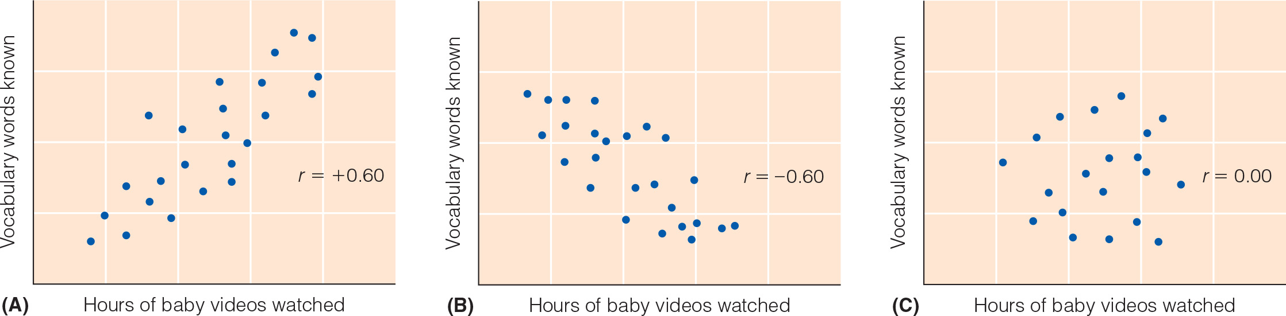
The Case Study, Experimental, and Correlational Methods (3 of 3)
  Calculate correlation coefficient (Pearson’s r)
    Index of the strength of the relationship between two variables of interest
    Ranges from +1.00 to −1.00
  Cannot determine cause/effect!
Notes:
Correlations assess pre-existing relationships

Slide 21
Developmental Research Designs
Cross-sectional design:
  Age effects and cohort effects are confounded.
  Cohort differences can tell us about the influence of the sociocultural environment on development.
  Researchers learn nothing about how people change with age.
  Relatively quick to conduct
Longitudinal design:
  One cohort of individuals is assessed repeatedly over time.
  Provides information about age changes rather than age differences
  Take a long time to complete!

Slide 22
Conducting Culturally Sensitive Research
Baltes’s life-span perspective emphasizes that development is shaped by its cultural context.
Most developmental research is WEIRD:
  People living in societies that are Western, Educated, Industrialized, Rich, and Democratic
Problem?

Slide 23
Protecting the Rights of Research Participants (1 of 2)
Research ethics:
  Standards of conduct to protect research participants from physical or psychological harm
  Federal regulations require organizations that conduct research with humans to have institutional review boards.

Slide 24
Research Ethics: Consent
Ethical Issues unique to studying Human Development:
Participation in a study must be voluntary!
Child assent: children’s agreement to participate
Passive consent: requiring parents to reply if they do not want their child to participate
Notes:
Learning Objective: 1-5: Examine developmental scientists’ obligation to conduct ethical research.
B. Ethical Issues in Studying Life Span Human Development
a. Informed Consent
i. Parents provide permission for minor children to participate, and this can raise issues
ii. Child assent: children’s agreement to participate in research
iii. Seeking consent from parents can interfere with researchers’ goals or may pose risks to minor participants
iv. Passive consent: procedures that typically involve notifying parents about the research and requiring them to reply if they do not want their child to participate
b. Confidentiality
i. Confidentiality: the assurance that participants’ responses will remain confidential and will not be disclosed to others
ii. Varying issues over when breaking confidentiality is ethical (e.g., risky behaviors)

Slide 25
Protecting the Rights of Research Participants (2 of 2)
Debriefing:
  Tell participants about the study afterward if they are not told everything in advance or are deceived.
  Explain the true purpose of the study.
  Obligation to make sure that participants do not leave feeling upset
Protection from harm:
  Researchers are bound to not harm research participants either physically or psychologically.
  If harm seems likely, researcher needs to find another method.
  Federal regulations provide extra protection from harm to children.

